Slide 1

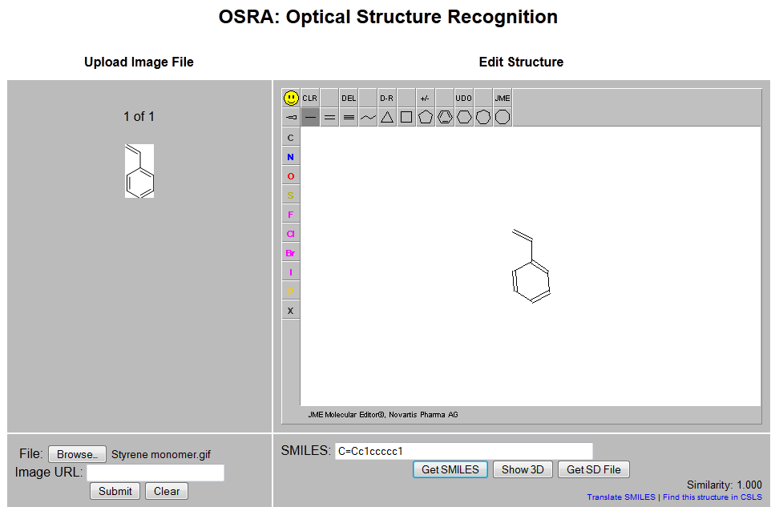
Small Molecule Example
Gif file: Styrene monomer.gif

Slide 2

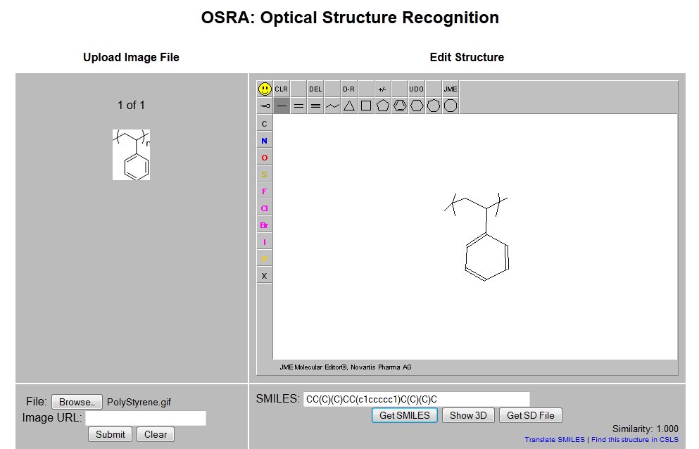
Polymer Example
Gif file: Polystyrene.gif

Slide 3
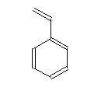
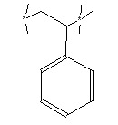
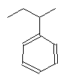
Polystyrene
 | Monomer | Polymer | Brackets Removed | Split Into End Groups and Polymer
Structure
OSRA |  | Note: the brackets are seen as bonds
SMILES | C=Cc1ccccc1 |  | CCC(C)c1ccccc1 | EG 1: C M: CCc1ccccc1 EG2: C

Slide 4
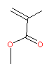
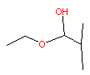
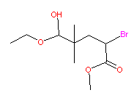
Poly methylacrylate
 | Monomer | Polymer | Brackets Removed | Split Into End Groups and Polymer
Structure
OSRA
SMILES | C=C(C)C(=O)OC |  | CCOC(O)C(C)(C)CC(Br)C(=O)OC | EG1: CCOC(=O)C(C)C M: CCC(=O)OC EG2: Br

Slide 5
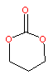
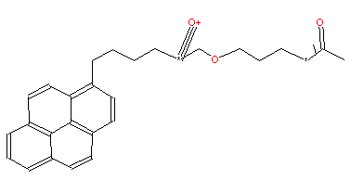

Polycarbonate
 | Monomer | Polymer | Brackets Removed | Split Into End Groups and Polymer
Structure
OSRA |  | Note: the brackets are seen as bonds | Note: structure is not correct
SMILES | O=C1OCCCO1 |  | Correct Smile String: CC(=O)OCCCOC(=O)OCCCCc1ccc2ccc3cccc4ccc1c2c34 | EG1: OCCCCc1ccc2ccc3cccc4ccc1c2c34 M: O=COCCCO EG2: CCO

